Slide 1

Seasonal Agriculture Performance Analysis
Sandeep
DTU-Delhi Technological University
AICTE STU ID : [STU694b812023ec81766555936]

Slide 2

PROBLEM STATEMENT
Farming outcomes shift a lot depending on the season — rainfall, temperature, soil conditions and even market prices all change between Kharif, Rabi and Zaid. On its own, the raw dataset doesn't make these differences obvious. This project looks at season-wise agricultural records to work out how yield, profit and resource use actually vary across seasons, and what's driving those differences.

Slide 3
Project Description
A season-wise study of Indian farm data — 4,000 records across Kharif, Rabi and Zaid, covering 8 crops and 8 states. After cleaning the data (120 missing values, no duplicates), I used visual and statistical analysis to uncover how yield, profit and resource use shift by season, and what patterns could guide better planning.

Slide 4

WHO ARE THE END USERS?
Farmers and growers deciding what to plant each season
Agricultural extension officers and policymakers shaping seasonal advisories
Agribusinesses, input suppliers and crop insurance providers
Researchers, students and analysts working with seasonal farm data

Slide 5

Technology Used
Python for the core analysis
Pandas and NumPy for cleaning the data
Matplotlib and Seaborn for visualizations
SciPy for statistical tests (Kruskal-Wallis, Mann-Whitney U)
Jupyter Notebook / Google Colab as the environment

Slide 6
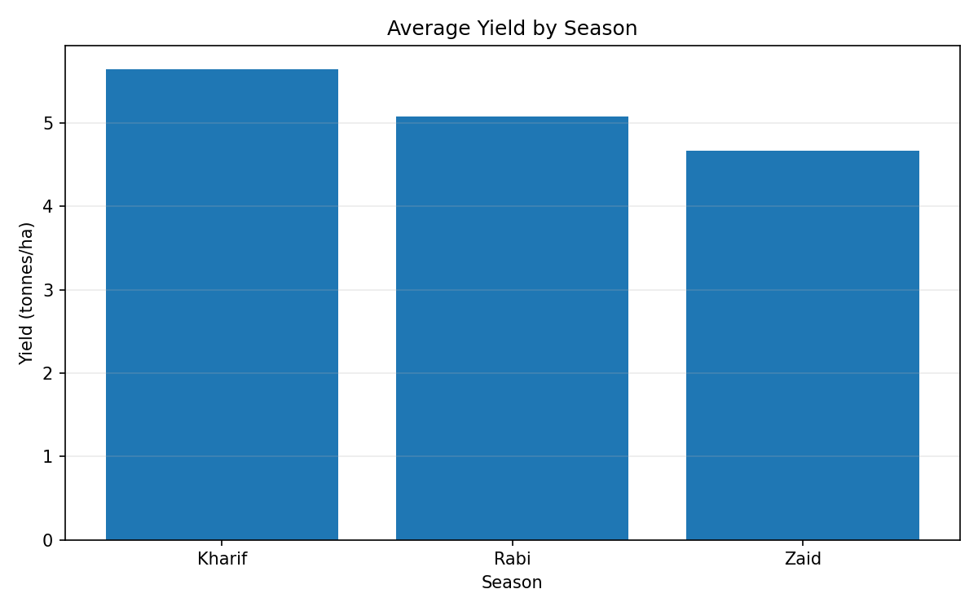
RESULTS
5.64 t/ha
Kharif's avg yield — highest of the 3 seasons
Kharif posted the highest average yield (5.64 t/ha), ahead of Rabi (5.08) and Zaid (4.67). An ANOVA test says this gap isn't statistically significant (p = 0.23) — yield stays fairly steady across seasons.

Slide 7
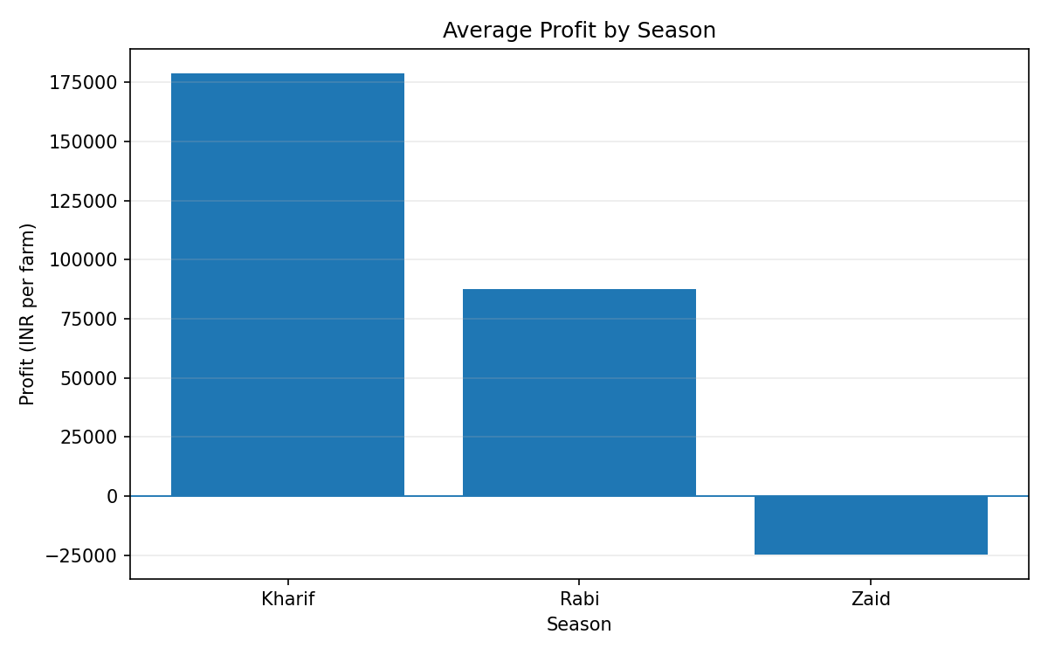
RESULTS
₹1.79L
Kharif's average profit per farm
Profit tells a different story. Kharif farms averaged ₹1,78,915 in profit — more than double Rabi's ₹87,689 — while Zaid ran at an average loss of ₹24,805. Unlike yield, this seasonal gap in profit is statistically significant (ANOVA, p < 0.001).

Slide 8
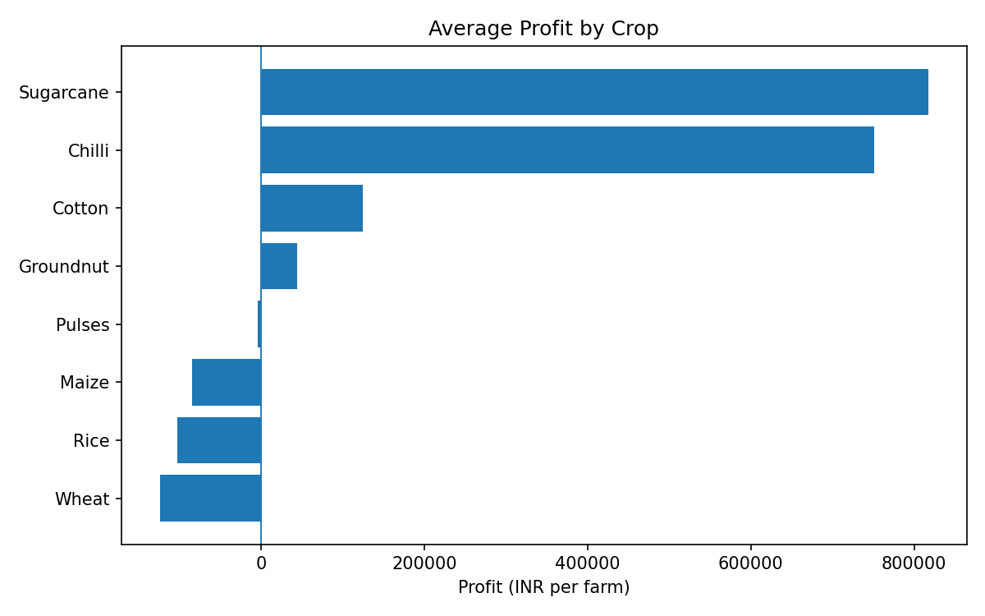
RESULTS
Sugarcane
Highest yield & profit of all 8 crops
Sugarcane leads on both fronts — 46.9 t/ha average yield and ₹8.17L average profit. Chilli is a close second on profit (₹7.5L) despite a modest yield. Wheat, Rice and Maize all ran at a loss on average.

Slide 9
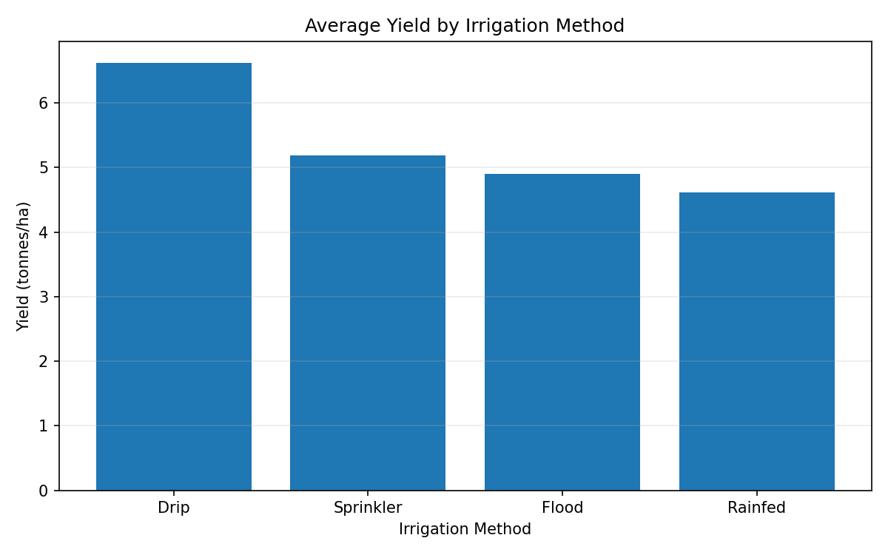
RESULTS
Drip irrigation
6.62 t/ha — the best-performing method
Drip irrigation clearly outperforms the rest, in both yield (6.62 t/ha) and profit (₹2.2L average) — well ahead of sprinkler, flood and rainfed methods.

Slide 10
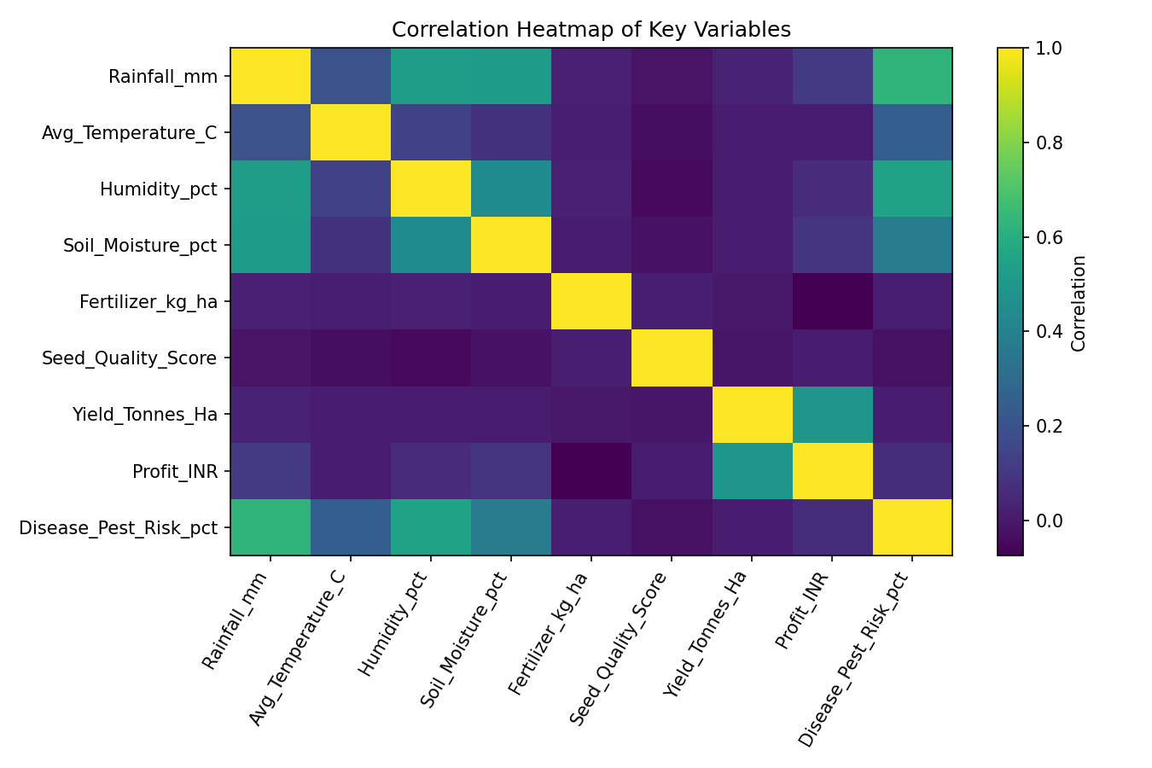
RESULTS
r = 0.49
Correlation between yield and profit
None of the environmental or input variables — rainfall, temperature, fertilizer, seed quality — correlate strongly with yield on their own. The strongest relationship in the whole dataset is between yield and profit.

Slide 11
Future scope
Develop ML models for crop yield and profit prediction.
Build a crop recommendation system based on soil and weather conditions.
Integrate real-time weather data for better seasonal predictions.
Develop smart irrigation and disease-risk prediction systems.
Convert the analysis into an interactive Streamlit/Power BI dashboard.

Slide 12
GitHub Link
https://github.com/sandeepece15/vi-internship

Slide 13

VOIS Course completion certificate -
Course name- Data Visualization

Slide 14
Thank you
“From Data to Decisions, From Decisions to Smarter Farming.”
Future Scope: Integrating Machine Learning and Generative AI can enable yield prediction, crop recommendation, disease-risk forecasting, intelligent irrigation, and personalized agricultural insights.
.
.

